Slide 1









Welcome to MGMT-6056 Project Cost Management & MGMT-6058 Project Time Management
Some slides are exclusive to either 6056 or 6058
Exercises
Do the exercise prior to next slide
Videos
Solution Slide
PPT Animations
Exercise Simulation
Module 1 - Introduction
See text in “slide note” for more details

Slide 2
Module Learning Outcomes
Understand the Program Expectations Module “0”
Review the Course Overview and the Course Schedule (Course at a Glance)
Understand the required resources for the program
Identify the characteristics of a project, and compare it to operations
Understand what the PMI organization is and the PMBOK
Understand where Cost Management and Time Management fit into a project
Recognize the importance of Project Teams
Math Review

Slide 3
MGMT 6056 Cost Course Outline PDF (See FOL/Content/Course Outline)
Define and develop project costs in the planning phase using estimating methods such as analogous, bottom-up, top down
Evaluate the various types of project costs
Manage resources for project activities
Translate the project WBS to a project budget and assess the linkages
Analyze project status and react to project changes, assess impacts and administer and manage changes to project budget
Assess PERT analysis, cost and schedule performance
Create, communicate and present project budget status reports
Develop risk-based funding contingency scenario

Slide 4
MGMT 6058 Time (Schedule) Course Outline PDF (See FOL/Content/Course Outline)
Identify and calculate appropriate project time estimates;
Define and sequence project activities;
Identify the critical path of project schedule;
Describe project float time analysis;
Create a Gantt chart to manage a project;
Measure and develop the Earned Value Management process;
Analyze, implement and manage project schedule changes;
Evaluate and control project schedule;
Communicate project schedule status with stakeholders.

Slide 5

Course Schedule (Course at a Glance)
Located on FOL under Content/Getting Started & Resources
Review the Course at a Glance
Subject to change
Course readings are on this document

Slide 6

Assignments
Dropbox Submission assignments are actually micro projects. Each assignment is an opportunity to perform a project.
Projects are about completing what’s required. Make sure you understand the detailed scope of your project (assignment).
Late Assignments will be graded as a zero, e.g. 2 seconds late means a zero for the assignment
You must submit the assignments by the scheduled time. Only prearranged exceptional circumstances will be considered for extensions.
If the assignment is worth 10% of the course or more, the penalty is 20% per day. One second late is a 20% penalty, and 24 hours plus one second is a 40% penalty.

Slide 7
Required Resources
Laptop with MS Project loaded, and other MS Office apps.
If you need MS Project you can get it for free (verify) from Fanshawe Help Desk
Texts (verify prices) and note these textbooks are required in more than one course.
A Guide to the Project Management Body of Knowledge (PMBOK Guide) Sixth Edition – become a Student Member of PMI.org and receive an electronic copy, see PMI slide.
A Systems Approach to Planning, Scheduling and Controlling by Harold Kerzner 12th Edition (preferred) or 11th Edition
Access to some free textbooks via web links may be provided by the College

Slide 8
PMI.org
Student Memberships (which include a PDF of the PMBOK Version 6, in lieu of a hard copy) were about ~$32 USD plus ~$20 for a local Chapter to join (verify these costs AS THEY CHANGE). The local chapter for London is the South Western Ontario (SWOC) chapter.
www.pmi.org
Along with a PDF version of the PMBOK, PMI membership provides access to PMI publications and global standards. Membership in a chapter provides networking options and online communities of practice, as well as leadership and volunteer opportunities.

Slide 9
What is a project?
What are your experiences with projects?
Everybody has managed a project or participated in a project!

Slide 10
Introduction
Examples of projects
Split the atom
Tunnel under the English Channel
Releasing Windows 11
Plan the next Olympic games
“Projects, rather than repetitive tasks, are now the basis for most value-added in business”
-Tom Peters

Slide 11
Process/Operations vs Projects
Process/Operations
Ongoing, day-to-day activities to produce goods and services
Use existing systems, properties, and capabilities
Typically repetitive
Project
Take place outside the normal, process-oriented world
Unique and separate from routine, process-driven work
Continually evolving
A project is a temporary endeavor undertaken to create a unique product, service or result.
PMBOK 2013

Slide 12
Project Definitions Summarized
A project can be considered any series of activities and tasks that have:
Specific objectives to be completed within certain specifications,
Defined start and end dates,
Funding limits,
Human and nonhuman resources, and a
Multifunctional focus.

Slide 13
Elements of Projects
Complex, one-time processes
Limited (constraints) by budget, schedule, resources, other
Developed to resolve a clear goal or set of goals – provide benefits
Customer-focused (internal or external)

Slide 14
General Project Characteristics
Ad-hoc endeavors with a clear life cycle
Building blocks in the design and execution of organizational strategies
Responsible for the newest and most improved products, services, result, and organizational processes
Provide a philosophy and strategy for the management of change

Slide 15
Project Success Rates Stats
Only 40% of projects at IBM meet their goals for: schedule, budget, and quality.
Only 2.5% of companies complete 100% of their project successfully
At least 16% of IT projects end up with a 200% cost overrun and a 70% schedule overrun
Only 58% of organizations really embrace the value of project management
“17% of IT projects can go so bad that they can threaten the very existence of the company.”
See more on this link: Source: Forbes, Why No One Can Manage Projects …

Slide 16
Teams and Groups - and Project Management

Slide 17
Effective Project Teams
Clear Sense of Mission
Productive Interdependency
Cohesiveness
Trust
Enthusiasm
Results Orientation

Slide 18
Reasons Why Teams Fail
Poorly developed or unclear goals
Poorly defined project team roles & interdependencies
Lack of project team motivation
Poor communication
Poor leadership
Turnover among project team members
Dysfunctional behavior

Slide 19
Why group projects?
Value of team skills after graduation: “If you can’t operate as a team player, no matter how valuable you’ve been, you really don’t belong at GE.” John F. Welch. CEO, General Electric. (1993)
During interviews, prospective employers often ask applicants questions about their teaming experiences.
Performance as a team often exceeds performance as individuals. Group Work at Prague College
Student teams provide a support system that students can use when they cannot find their professor, don’t remember their homework, etc.

Slide 20
PMBOK ITTO’s and Introduction to Project Management Videos

Slide 21
Guide to PMP® ITTO (Inputs, Tools, Techniques and Outputs)
Inputs
Tools & Techniques
Outputs
Paper
Cutting & Folding
Paper Airplane
Nouns
Verbs
Nouns
https://www.project-management-prepcast.com/pmp-itto
Scroll down to “What does ITTO stand for?” in the link:

Slide 22
Guide to PMP® ITTO (Inputs, Tools, Techniques and Outputs)
See Can ITTO Outputs also be Inputs?
Input
Tools & Techniques
Output
Paper
Cutting & Folding
Paper Airplane
Paper Airplane & Paint
Sketching & Painting
Painted Paper Airplane
Input
Tools & Techniques
Output

Slide 23
Great Introductory Videos to Project Management
How to Become a Project Manager
https://www.youtube.com/watch?v=aBxxSZsFf3s 1:57
What is project management?
https://www.youtube.com/watch?v=Jk-JwtScIlw 2:17
Titanic - Project Management Blunders, Interview (Part 1)
https://www.youtube.com/watch?v=ikDd2XijiEA 7:46
Over budget and behind schedule, Toronto Union Station project
http://www.theglobeandmail.com/news/toronto/massive-renovation-of-torontos-union-station-over-budget-behind-schedule/article18840369/ 19:11

Slide 24
Take a look at the PMBOK for Cost

Slide 25
Overview of the Project Management Institute’s PMBOK Knowledge Areas & Cost Management
What are Process Groups vs Knowledge Areas? See next slide.
Source: PMBOK 6th Edition, 2017

Slide 26
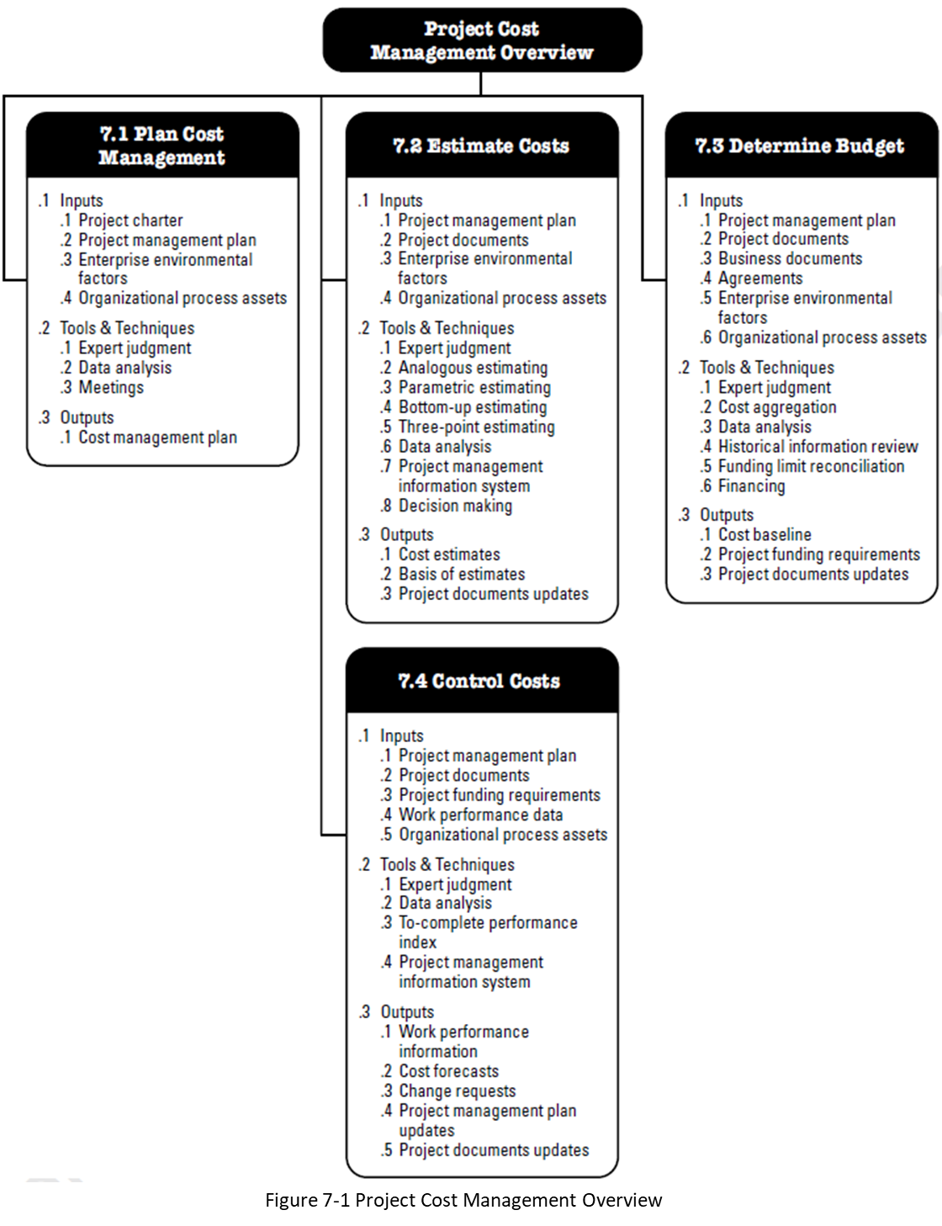
This course will focus on the Project Cost Management Knowledge Area
Source: PMBOK 6th Edition, 2017

Slide 27
Take a look at the PMBOK for Time (Schedule Management)

Slide 28
Overview of the Project Management Institute’s PMBOK Knowledge Areas & Schedule Management (Time)
What are Process Groups vs Knowledge Areas? See next slide.
Source: PMBOK 6th Edition, 2017

Slide 29
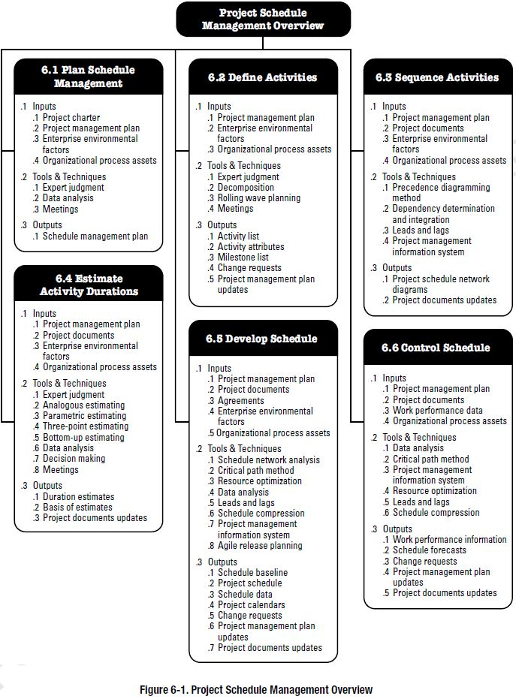
The 6058 course will focus on the Project Schedule Management (Time) Knowledge Area
Source: PMBOK 6th Edition, 2017

Slide 30
Math Review and Business Math

Slide 31
Algebra Introduction - Multiplication
Work your way through this webpage, try the example questions https://www.mathsisfun.com/algebra/introduction-multiply.html
Try the business problem: We want to figure out the cost for a box of specialty tiles. Last time we received them we had to pay $456 for our half of the box (we split the box with someone else). Our $456 cost included $57 for delivery of our half. What is the cost of a box of these tiles before any delivery charges?
Notes:
Box/2 + $57 = $456
Box/2 + $57 - $57 = $456 - $57
Box/2 = $399
Box
---- x 2 = $399 x 2 Box = $798
2

Slide 32
Order of Operations PEMDAS
Work your way through this webpage but stop after the first 3 example questions https://www.mathsisfun.com/operation-order-pemdas.html
Try the business problem: We are estimating the flooring cost of a square room including tax, each side is 8m. The cost for the flooring is $126 per square metre and the padding underneath is $16 per m². HST is 13%. What is the estimate?
Notes:
8² x ($126 + $16) x 1.13 = Estimate
64 x ($126 + $16) x 1.13 = Estimate
64 x $142 x 1.13 = Estimate
$10,269.44 = Estimate
But you may prefer to write it as:
(Carpet area in square metres x $ per square metre) x HST increase = Estimate
[8² m sq’d x ($126 + $16)$ per sq m] x 1.13 = Estimate Note, square brackets “[“, “]” used for clarity

Slide 33
Introduction to Percent
Work your way through this webpage , try the example questions https://www.mathsisfun.com/percentage.html
Try the business problem: We had to pay an extra fee on a pump we bought because it is a ”rush order”, We need another pump but this time it’s no rush. We are told because there’s no rush the new pump will be 17% less. We paid $3,860 for the old pump not including tax. What will be the cost of the new pump?
Notes:
How much less will the new pump be?
$3,860 x 17% = $656.20
So the new pump will be $3,860 - $656.20 = $3,203.80
Or
A faster way of doing this is the new pump will be (1-17%) of the old pump.
$3,860 x 83% = $3,203.80
Note, we can NOT divide the new pump by 1.17 to get the new pump cost

Slide 34
Significant Digits Definition
Work your way through this webpage https://www.mathsisfun.com/definitions/significant-digits.html
Use the widget on the webpage and enter 563.140001. Then use the arrow buttons to confirm how many significant digits there are.
Then try 0.003001
We are asked to provide exactly 4 significant digits (for accuracy), for the cost of each titanium fastener. The box is $495 and there are 400 fasteners in a box.
Notes:
For 563.140001, you’d have to click on the arrow button and display 9 significant digits to match the numbers.
For 0.003001, you’d have to click on the arrow button and display 4 significant digits to match the numbers
Each fastener is $495/400 = $1.2375 but since we are asked for exactly 4 digits it’s $1.238
Note – the consistent use of at least 4 significant figures throughout a calculation is required for quizzes and exams. If you don’t, you will probably get an incorrect answer.

Slide 35
Unit Price
Work your way through this webpage , try the example questions https://www.mathsisfun.com/measure/unit-price.html
Try the business problem: a) We bought a US gallon can of aviation paint for $480 Canadian. There are 3.78541 litres in a US Gallon. What does a litre of paint cost? b) What would be the unit cost per litre including shipping if we paid $38 to ship the can?
Notes:
a) $480 CAD per gallon / 3.78541 litres/gallon = Unit Cost per litre
$480 / 3.78541 = $126.80 per litre
b) ($480 + $38) / 3.78541 litres/gallon = Unit Cost per litre including shipping
$518 / 3.78541 litres/gallon = $136.84 per litre (shipped)

Slide 36
Decimals, Fractions and Percentages
Work your way through this webpage, try the example questions https://www.mathsisfun.com/decimal-fraction-percentage.html
Try the business problem: We received 32 rolls of fiber optic cable to rewire a building. On Monday we used 4 rolls for the 2nd floor and on Tuesday we finished wiring the floor and used another 3 rolls. What percent of the wiring was used on the 2nd floor?
Notes:
(4+3)/32 = 7/32 = 21.875% is the correct answer. 0.21875 is NOT the correct answer because we were asked for the percent from the fraction 7/32, NOT the decimal.

Slide 37
Business Math Skills – FOL Quizzes
The math skills required for these courses are primarily “business math”. The context of the question is important in order to understand what is being asked. Start assessing your skills now, complete the set of M1 Practice Quizzes – you need to know your skill level.
In FOL, under Content/Getting Started and Resources, you will find an additional quiz resource, “Business Math Practice Questions from Quizizz.com”. These quizzes will also help you to assess your business math skills.
There are some FOL Practice Quizzes with module math Questions available throughout the course. These are unlimited attempts with scores provided immediately after you finish.
If you score a 2 out of 4, and you want to know which ones you didn’t get correct, you can take the quiz again answering just one question. If you got 1 point for your score, you know you answered it correctly.
You may find that you are “rusty” in math in which case the Library Learning Commons offers free math help. https://www.fanshawelibrary.com/drop-in-math/

Slide 38
Summary of Module
Understand the Program Expectations Module “0”
Review the Course Overview and the Course Schedule (Course at a Glance)
Understand the required resources for the program
Identify the characteristics of a project, and compare it to operations
Understand what the PMI organization is and the PMBOK
Understand where Cost Management and Time Management fit into a project
Recognize the importance of Project Teams
Math Review

Slide 39
Homework
Buy or source textbooks and get MS Project loaded
Review your Course at a Glance found on FOL/Content/Getting Started and Resources
Practice your Business Math skills by selecting and answering questions from the Business Math Practice Questions topic found on FOL Content/Getting Started & Resources
For both 6056 and 6058
Read for M1
Kerzner 12th Ed p 2-7, 11th p. 2-7
PMBOK 6th Ed 1.2.1, 1.2.2
Also read, for the next module, M2
Kerzner 12th Ed p 360-373, 11th p. 519-541
PMBOK 6th Ed 5.3, 5.4
Reading list is also provided in the Course at a Glance document, found at FOL/Content/Getting Started and Resources

